Slide 1
Bootstrap
Week 4

Slide 2
History
Programmers are lazy
They spend person-decades of effort, so their next job is easier
Twitter programmers didn’t like designing multiple stylings for Twitter to look the same in Safari, Chrome, FireFox, IE-7,….
So, they created a style sheet the was knowledgeable about the different browsers so, they didn’t need to be
They put the brains in the CSS and JS files.

Slide 3
Works the same everywhere
Styling is standardized for:
Different browsers
Different screen formats (phone, tablet, laptop, desktop)
Frequently used Components are designed once
Images
Carousels
Nav bars
Buttons
forms
Customizable
Don’t like the default colors? They can be changed

Slide 4
What is the magic sauce?
The magic lies in the Bootstrap CSS file
Add this inside your <head> tag and you gain access to the Bootstrap styling classes
<link rel="stylesheet" href="https://maxcdn.bootstrapcdn.com/bootstrap/4.4/css/bootstrap.min.css">
You can get the bootstrap.css file from the source, copy it to your local server or find it on a third-party server

Slide 5
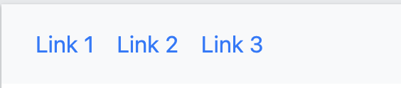

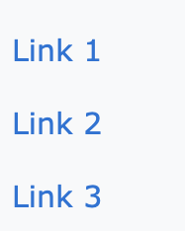
How is it done? Navbar example
Primarily by adding a class to an element
<nav class="navbar navbar-expand-sm">
<ul class="navbar-nav">
<li class="nav-item">
<a class="nav-link" href="#">Link 1</a>
</li>
<li class="nav-item">
<a class="nav-link" href="#">Link 2</a>
</li>
<li class="nav-item">
<a class="nav-link" href="#">Link 3</a>
</li>
</ul>
</nav>
Want a dark theme?
Add bg-dark to the nav tag
Want vertical menu?
Remove
Navbar-expand-sm

Slide 6
Bootstrap Columns
Bootstrap slices the page into 12 columns
You can define a <div> to consume 1 to 12 columns
You can define how many columns are allocate for each screen size
col-lg-2 large (desktop) - your image or text fits fine in 2 cols
col-md-4 medium (laptop) - now your image takes 4 cols
col-sm-6 small (tablet) - needs 6 cols to adequately show the image
col-xs-12 Extra small (phone) – to see the image now you need the full width of the screen

Slide 7
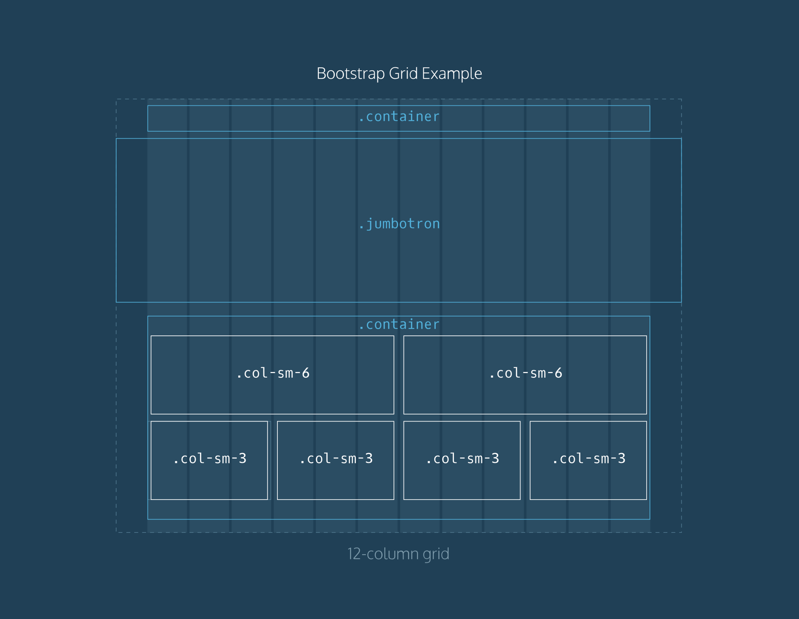
Bootstrap Grid System

Slide 8
Let’s look at simple row
We define the contents of a row with the row class.
Kind of link the <tr> for a table
<div class="row”> your visible stuff goes in here </div>
<div class="col-lg-2 col-md-3 col-sm-6 col-xs-12 borders">Col 1</div> <div class="col-lg-2 col-md-3 col-sm-6 col-xs-12 borders">Col 2</div> <div class="col-lg-2 col-md-3 col-sm-6 col-xs-12 borders">Col 3</div> <div class="col-lg-2 col-md-4 col-sm-6 col-xs-12 borders">Col 4</div> <div class="col-lg-2 col-md-4 col-sm-6 col-xs-12 borders">Col 5</div> <div class="col-lg-2 col-md-4 col-sm-6 col-xs-12 borders">Col 6</div>
Let’s see what happens with this content when we start with a large screen and shrink the page width

Slide 9
Large Screen
All <DIV>s are defined col-lg-2
6 x 2 is 12 so all the <div>s fit just fine across the monitor
<div class="col-lg-2 col-md-3 col-sm-6 col-xs-12 borders">Col 1</div> <div class="col-lg-2 col-md-3 col-sm-6 col-xs-12 borders">Col 2</div> <div class="col-lg-2 col-md-3 col-sm-6 col-xs-12 borders">Col 3</div> <div class="col-lg-2 col-md-4 col-sm-6 col-xs-12 borders">Col 4</div> <div class="col-lg-2 col-md-4 col-sm-6 col-xs-12 borders">Col 5</div> <div class="col-lg-2 col-md-4 col-sm-6 col-xs-12 borders">Col 6</div>

Slide 10
Medium Screen
<DIV>s 1,2,3 are defined col-md-3
<DIV>s 4,5,6 are defined col-md-4
3 + 3 + 3 + 5 = 13!
Too many! Only 12 allowed per row.
Put as many as you can on a row and move the rest to the next row
<div class="col-md-3 col-sm-6 col-xs-12 borders">Col 1</div> <div class="col-md-3 col-sm-6 col-xs-12 borders">Col 2</div> <div class="col-md-3 col-sm-6 col-xs-12 borders">Col 3</div> <div class="col-md-4 col-sm-6 col-xs-12 borders">Col 4</div> <div class="col-md-4 col-sm-6 col-xs-12 borders">Col 5</div> <div class="col-md-4 col-sm-6 col-xs-12 borders">Col 6</div>

Slide 11
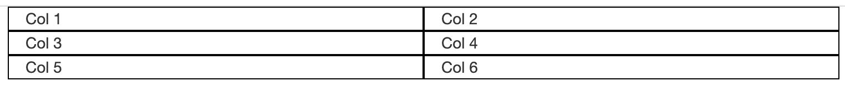
Small Screen
<DIV>s 1 through 6 are defined col-md-6
6 + 6 = 12
Only 12 columns allowed per row
Put as many as you can on a row and move the rest to the next row
We end up with 3 rows. 2 <DIV>s per row
<div class="col-sm-6 col-xs-12 borders">Col 1</div> <div class="col-sm-6 col-xs-12 borders">Col 2</div> <div class="col-sm-6 col-xs-12 borders">Col 3</div> <div class="col-sm-6 col-xs-12 borders">Col 4</div> <div class="col-sm-6 col-xs-12 borders">Col 5</div> <div class="col-sm-6 col-xs-12 borders">Col 6</div>

Slide 12
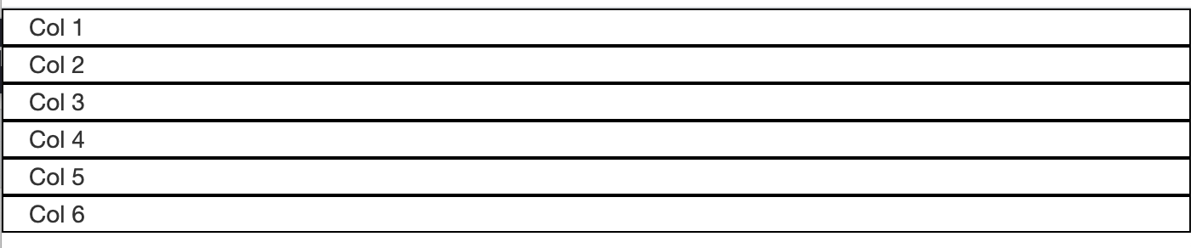
Extra Small Screen
<DIV>s 1 through 12 are defined col-xs-12
12 = 12!
Only 12 <div>s allowed per row
Put as many as you can on a row and move the rest to the next row
We end up with 3 rows. 2 columns per row
<div class="col-xs-12 borders">Col 1</div> <div class="col-xs-12 borders">Col 2</div> <div class="col-xs-12 borders">Col 3</div> <div class="col-xs-12 borders">Col 4</div> <div class="col-xs-12 borders">Col 5</div> <div class="col-xs-12 borders">Col 6</div>

Slide 13
Doing Forms with Bootstrap
Check out this gist
https://gist.github.com/89601b7f83ca9a8d6c7962c5d0707d06

Slide 14
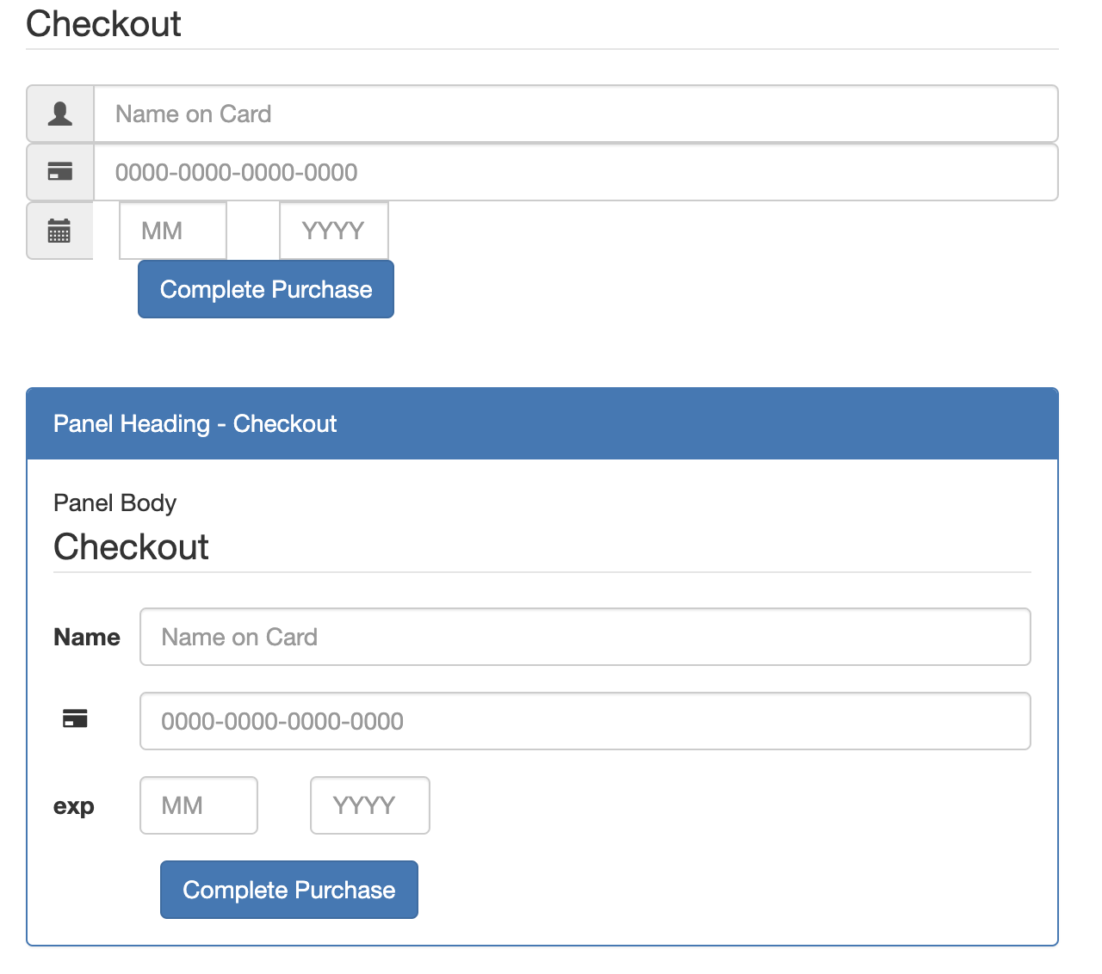
Two different Form styles
The top form uses the class: form-horizontal
<form class="form-horizontal narrow">
The lower form use two classes panel panel-primary
<div class="panel panel-primary narrow">
You could also try panel-default, panel-success, panel-info, panel-warning, or panel-danger

